Slide 1
Project 2 Presentation: Team Amplifier

Slide 2
Overview

Slide 3
Overview
Diablo 3 Fan-Site:

Slide 4
Overview
Diablo 3 Fan-Site:
Intro

Slide 5
Overview
Diablo 3 Fan-Site:
Intro
User Stories

Slide 6
Overview
Diablo 3 Fan-Site:
Intro
User Stories
Database Interactions

Slide 7
Overview
Diablo 3 Fan-Site:
Intro
User Stories
Database Interactions
Site Design

Slide 8
Overview
Diablo 3 Fan-Site:
Intro
User Stories
Database Interactions
Site Design
Welcome!

Slide 9
Intro:
Who
What
How

Slide 10
Intro:
Who
Team Amplifire:
What
How

Slide 11
Intro:
Who
Team Amplifire:
Calvin (Lead), Levi(DevOps Engineer), Patrick(GitFlow Master), Julian, Joachim
What
How

Slide 12
Intro:
Who
Team Amplifire:
Calvin (Lead), Levi(DevOps Engineer), Patrick(GitFlow Master), Julian, Joachim
What
Diablo III Fan-Site:
How

Slide 13
Intro:
Who
Team Amplifire:
Calvin (Lead), Levi(DevOps Engineer), Patrick(GitFlow Master), Julian, Joachim
What
Diablo III Fan-Site:
An end-to-end web application serving fans of Blizzard property - (Diablo III) with a chance to share and comment on gameplay images and character builds
How

Slide 14
Intro:
Who
Team Amplifire:
Calvin (Lead), Levi(DevOps Engineer), Patrick(GitFlow Master), Julian, Joachim
What
Diablo III Fan-Site:
An end-to-end web application serving fans of Blizzard property - (Diablo III) with a chance to share and comment on gameplay images and character builds
How
Tech Stack:

Slide 15
Intro:
Who
Team Amplifire:
Calvin (Lead), Levi(DevOps Engineer), Patrick(GitFlow Master), Julian, Joachim
What
Diablo III Fan-Site:
An end-to-end web application serving fans of Blizzard property - (Diablo III) with a chance to share and comment on gameplay images and character builds
How
Tech Stack:
Back-End: PostgreSQL, Java 8, Spring 5; Front-End: HTML, CSS, JavaScript; Testing: JUnit, Mockito, Jacoco; CI/CD: Amazon AWS (Code Pipeline, Codebuild, Elastic Beanstalk, S3)

Slide 16

User Stories
“Time to dunk on some weebs…”

Slide 17
User Stories
Viewer - casual visitor/no account
“Time to dunk on some weebs…”

Slide 18
User Stories
Viewer - casual visitor/no account
User - registered user
“Time to dunk on some weebs…”

Slide 19
User Stories
Viewer - casual visitor/no account
User - registered user
Admin - moderator with admin privileges
“Time to dunk on some weebs…”

Slide 20
User Stories
Viewer - casual visitor/no account is able to:
“...I got your ‘can’t teach an old dog new aggro’...”

Slide 21
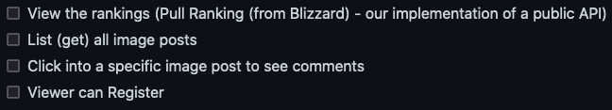
User Stories
Viewer - casual visitor/no account is able to:
“...I got your ‘can’t teach an old dog new aggro’...”

Slide 22
User Stories
Viewer - casual visitor/no account is able to:
2. User - registered user is able to:
“...I got your ‘can’t teach an old dog new aggro’...”

Slide 23
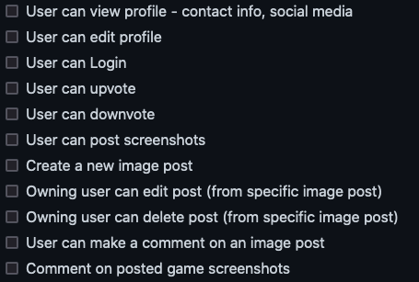
User Stories
Viewer - casual visitor/no account is able to:
2. User - registered user is able to:
“...I got your ‘can’t teach an old dog new aggro’...”

Slide 24
User Stories
3.3. Admin is able to:
Viewer - casual visitor/no account is able to:
2. User - registered user is able to:
“...I got your ‘can’t teach an old dog new aggro’...”

Slide 25
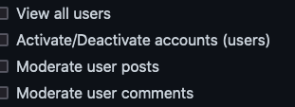
User Stories
3.3. Admin is able to:
Viewer - casual visitor/no account is able to:
2. User - registered user is able to:
“...I got your ‘can’t teach an old dog new aggro’...”

Slide 26
DataBase Interaction

Slide 27
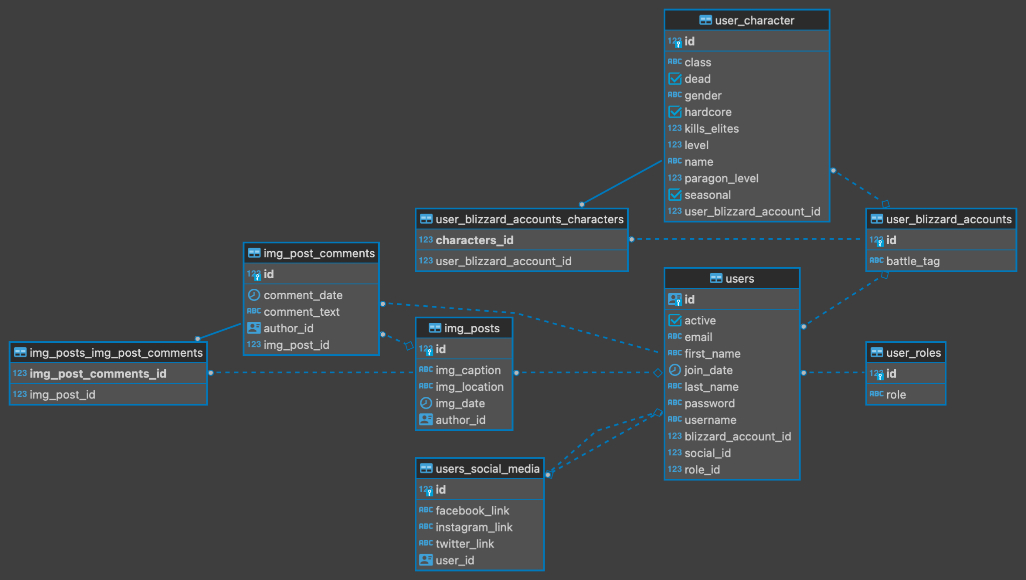
DataBase Interaction

Slide 28
API
“...stop asking me stupid questions…I’m going with amplifire. With them, it’s about the end-user, with you I’m at my wit’s end!!”

Slide 29
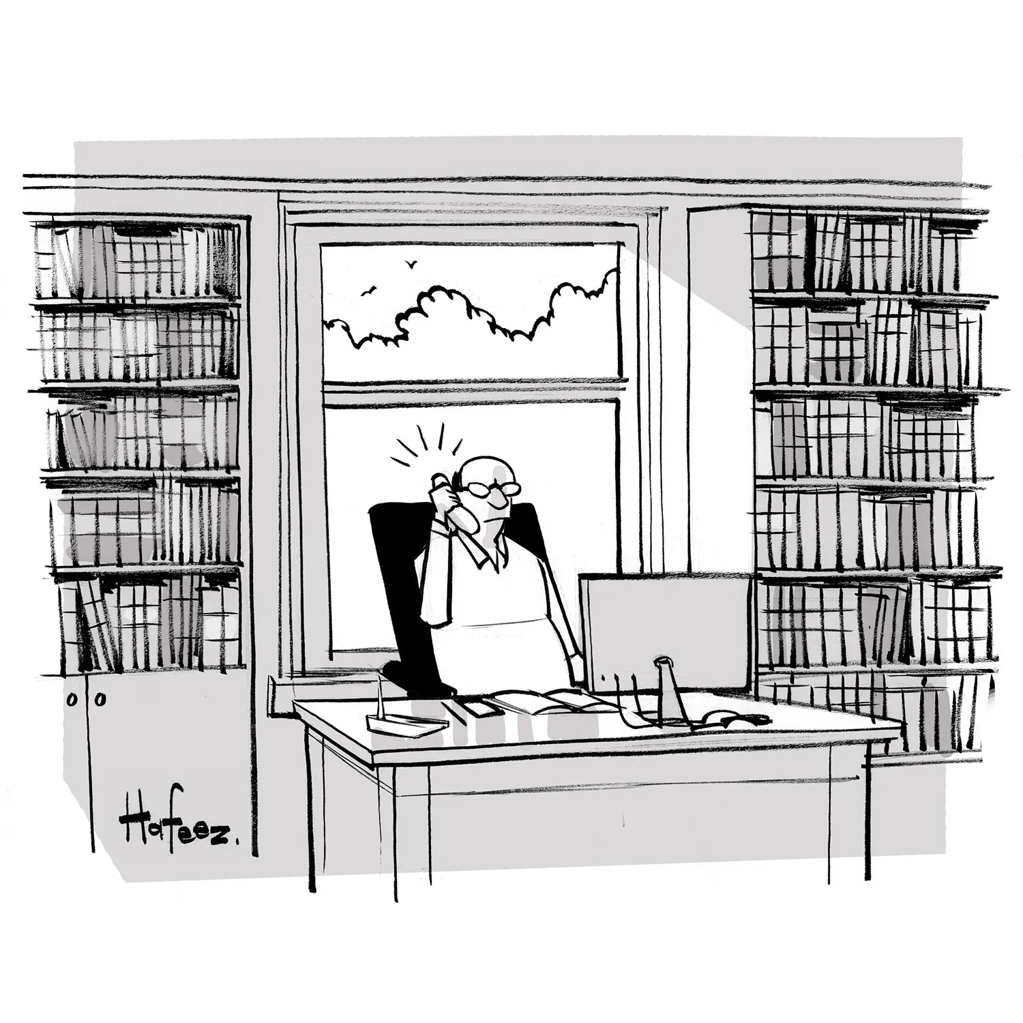
API
“...stop asking me stupid questions…I’m going with amplifire. With them, it’s about the end-user, with you I’m at my wit’s end!!”

Slide 30
API
https://p2amplifier.docs.apiary.io/#
“...stop asking me stupid questions…I’m going with amplifire. With them, it’s about the end-user, with you I’m at my wit’s end!!”

Slide 31
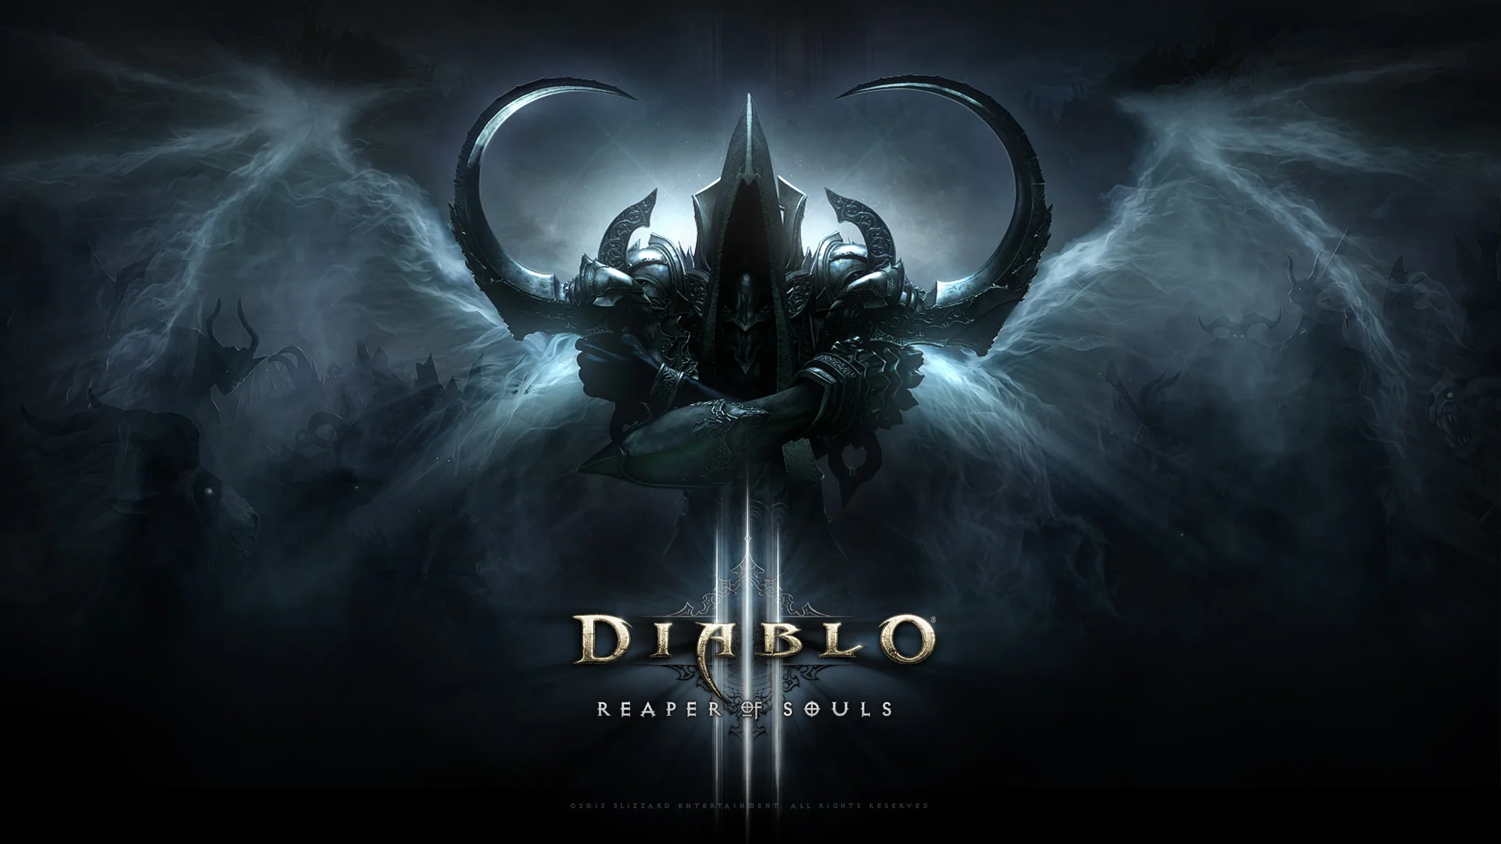
Welcome!
Feel free to tour our site:
(homepage URL)

